Slide 1
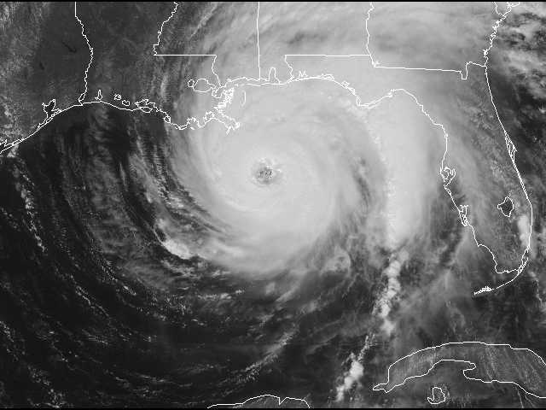
Climate and Weather

Slide 2
Today’s class
Map projection leftovers
Air pressure and winds
Climate comparisons
Weather: hurricanes

Slide 3
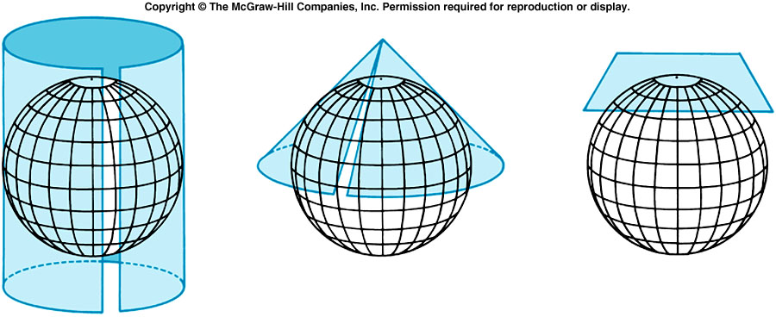
Map projections
Project a round globe onto a flat surface
Options?
Stretch out some areas
Cut out some areas
Shrink some areas

Slide 4
Map projections
Three properties to consider
  Area (equal-area or equivalent)
  Shape (conformal)
  Distance (equidistant)
  Choose two out of three
How large an area?
Purpose of the map
Ulterior motives?

Slide 5
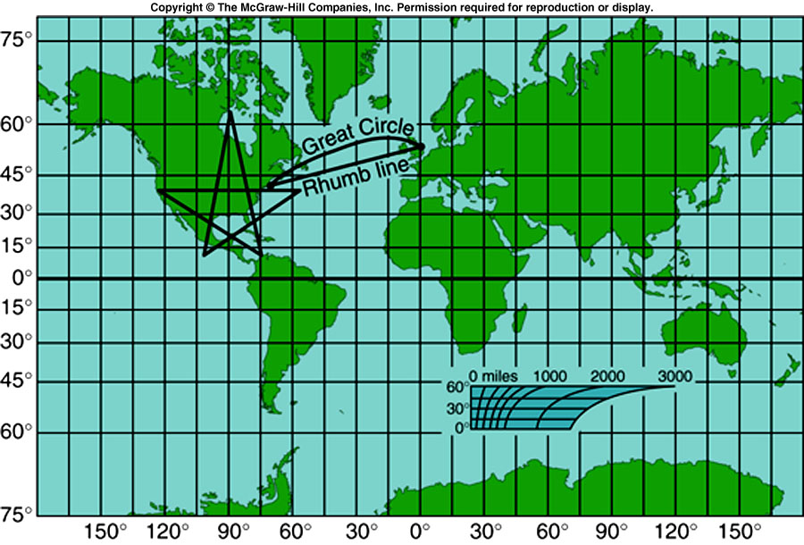
Cylindrical projections
Shapes are preserved
But not area!
Mercator projection
Deliberate distortion?
  Cold War
  Colonialism

Slide 6
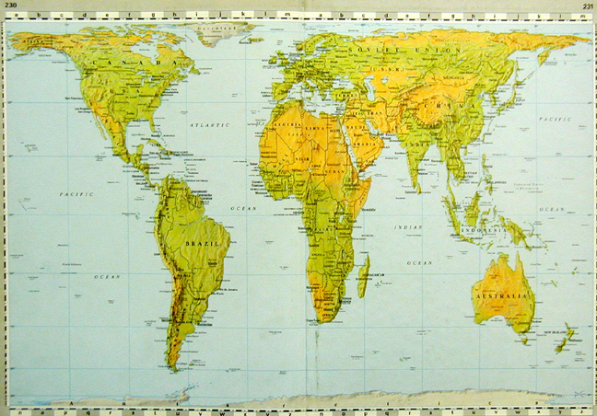
Cylindrical projections: Gall- Peters
Adjusting Mercator for a more “just” map
Also preserves area
Distorts shape differently

Slide 7
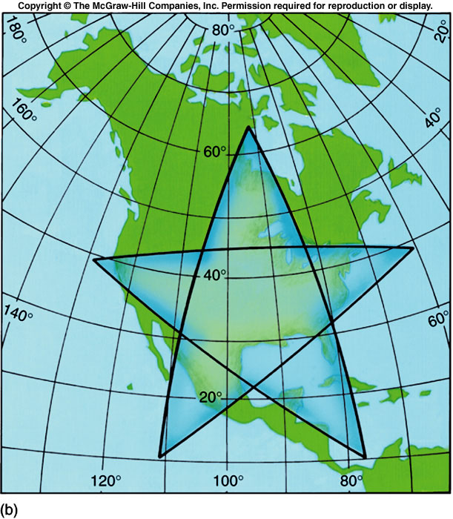
Conic projections
Best for hemispheres or small regions
Area and shape only slightly distorted

Slide 8
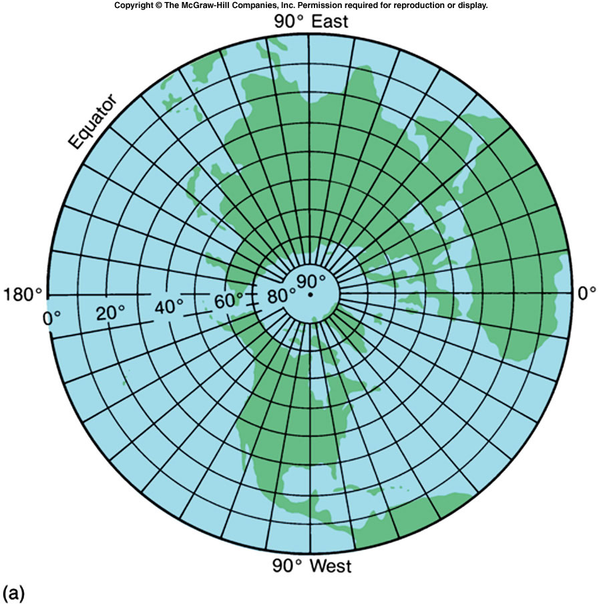
Planar projections
Equidistant; good for navigation
Only good for one hemisphere
Distorts area, not shape

Slide 9
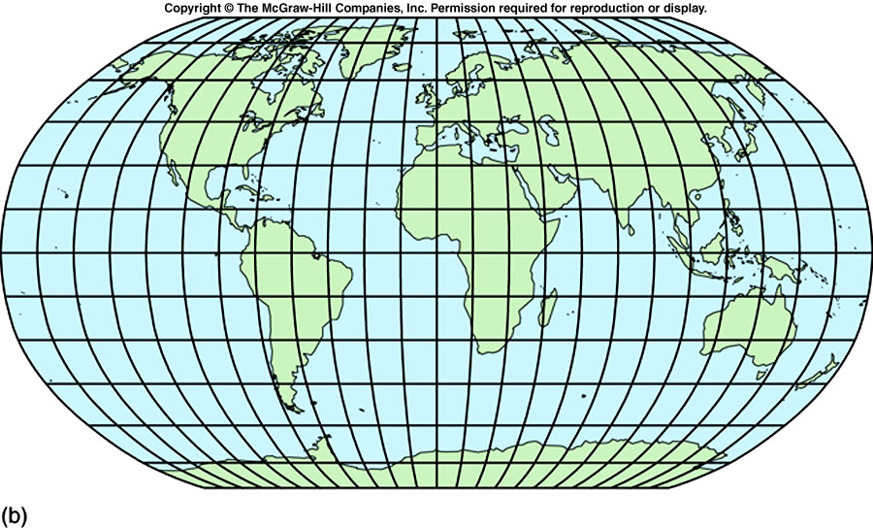
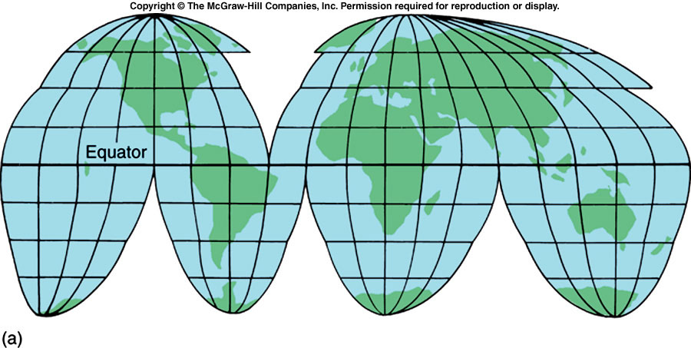
Other projections
Based on more complicated math
Interrupted, oval, combination
Robinson
Goode

Slide 10
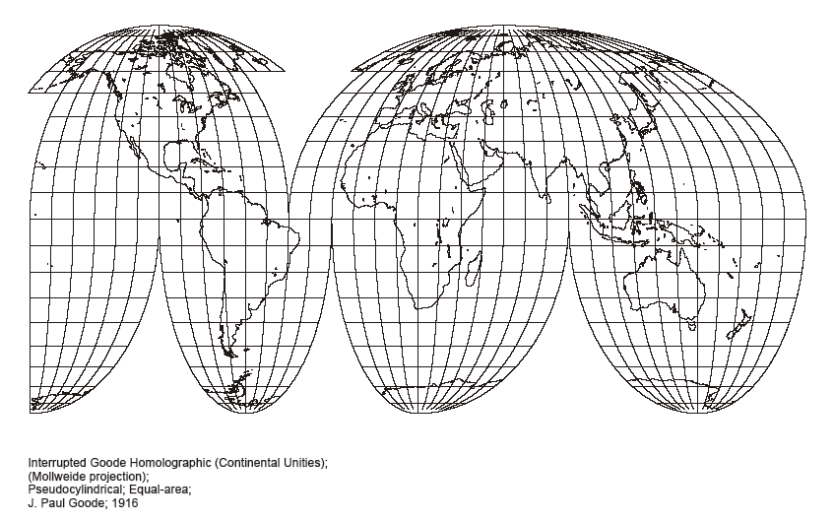
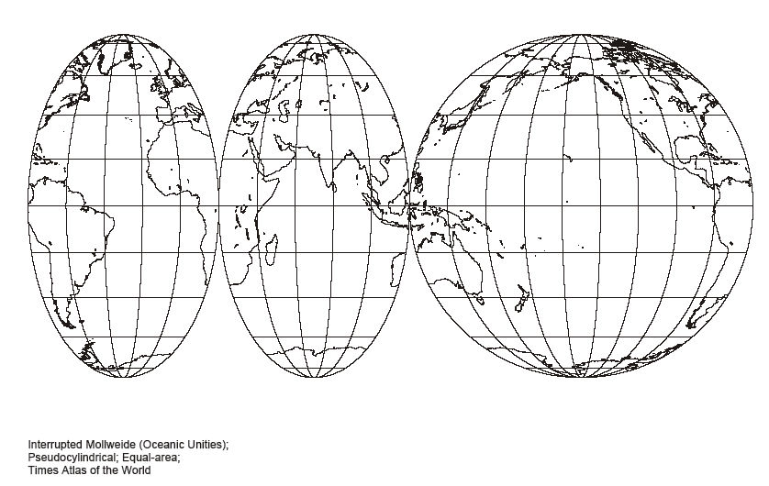

Slide 11
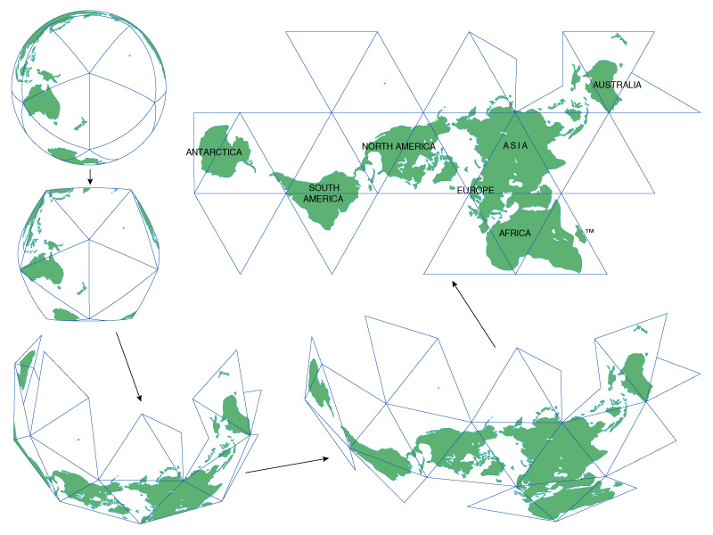
Dymaxion

Slide 12
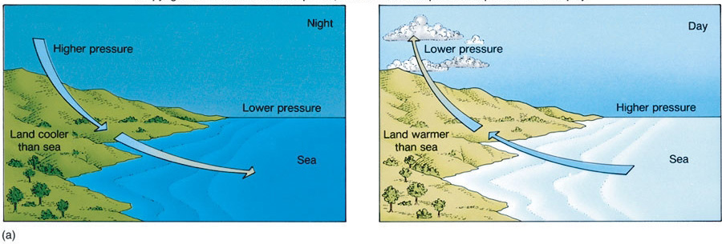
Air pressure and winds
Air is a fluid
Warmer air is less dense
Air moves from dense to less dense conditions
Ex.: Land-sea breezes

Slide 13
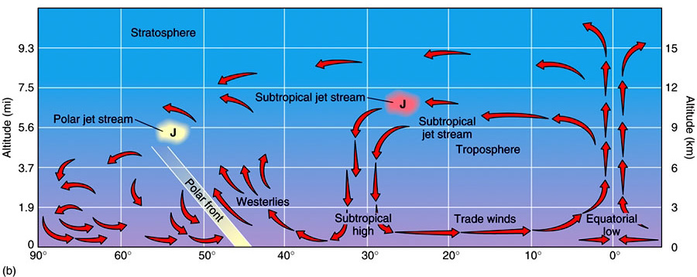
Global air circulation
Equator receives most insolation
Hot air rises, heads towards poles
Air becomes heavy and sinks at 30°N and S
Plus the Coriolis effect

Slide 14
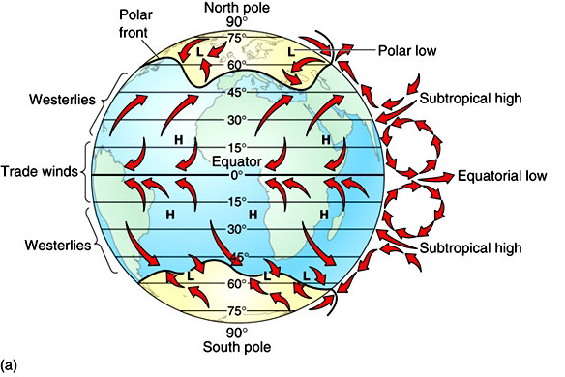
Warmer air “holds” more water
Low pressure=warm air=precipitation
High pressure=cold air=dry air

Slide 15
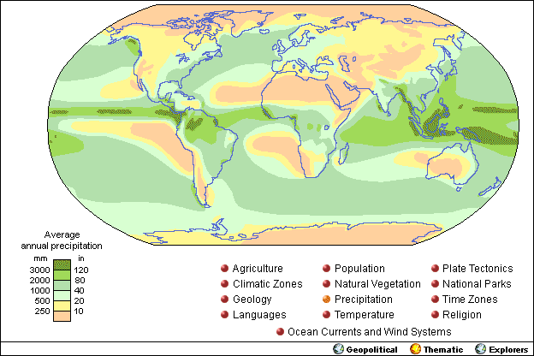

Slide 16
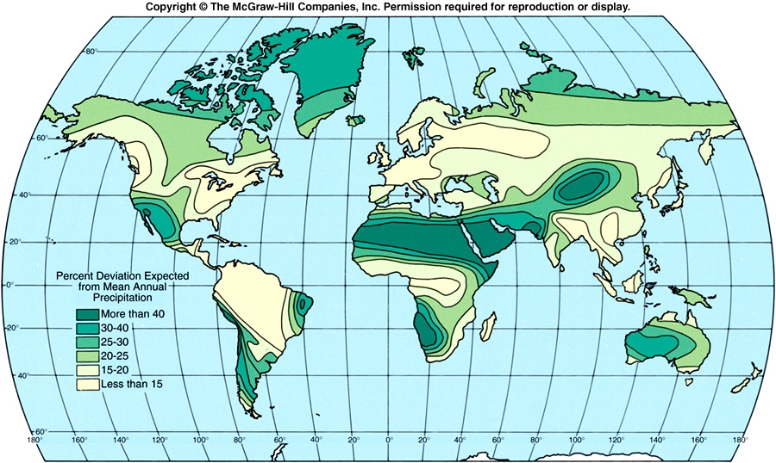

Slide 17
Ocean currents
Follow same circular pattern (driven by wind)
Warm currents flow away from equator, pile up on eastern shores
  Gulf Stream, Brazil
Cold currents flow towards equator, cause upwelling
  Humboldt/Peru, California

Slide 19
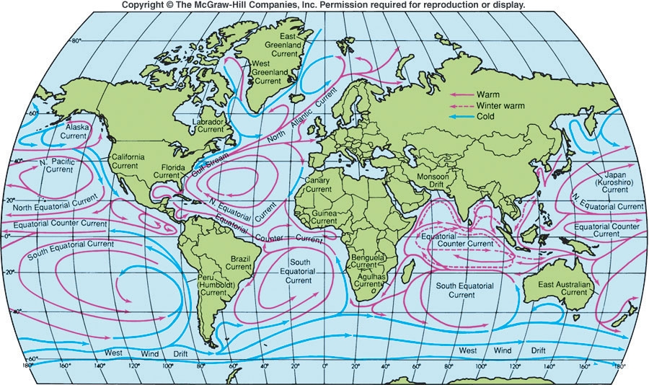

Slide 20
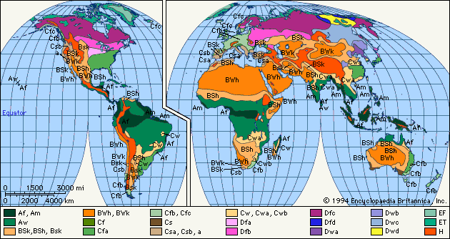
Climate classification
Temperature and precipitation
Köppen classification system
Nine types, plus highlands

Slide 21
Climate classification
Form groups according to climate
Verify your answers
Look at South America: find a city or country with your climate
  (Humid continental and subarctic/tundra, use North America—why?)
Explain how insolation, global air circulation, altitude, and land/water proximity make your place have the climate that it does

Slide 22
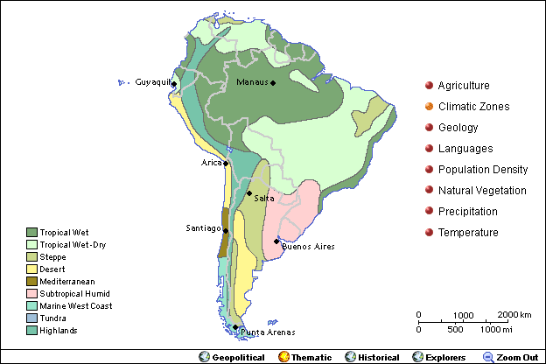

Slide 23
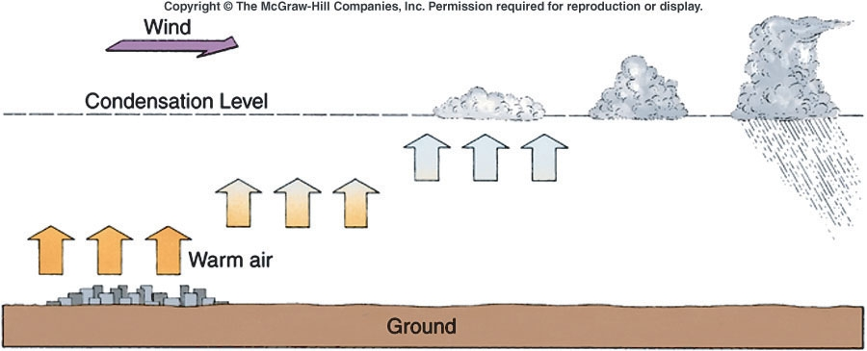
Weather: hurricanes
Start at low pressure centers
Warm air rises
Water evaporates with energy from sun
With condensation, energy is released

Slide 24
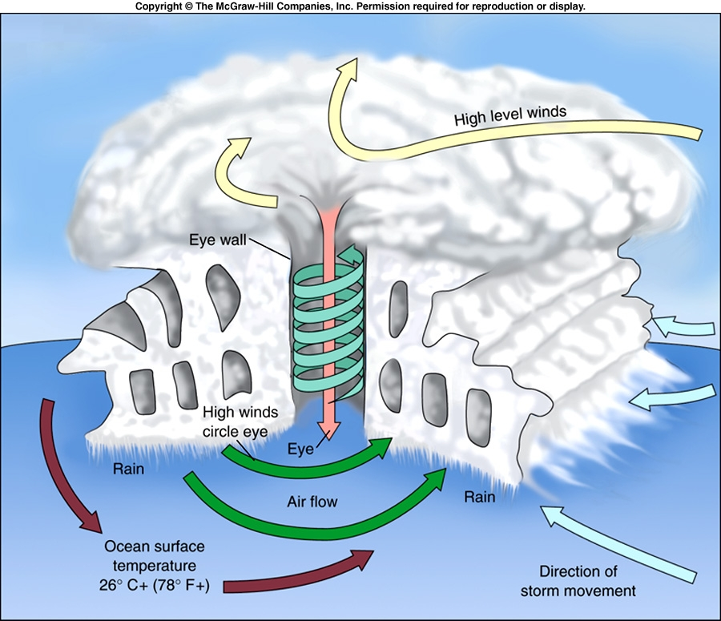

Slide 25
